Slide 1

1/6 Report
By Bolun

Slide 2
Start
One iteration with putting back points（fixed）
Method 2
( Method 1 is Using LP only)
Input Data
Solve LP
Delete Outliers from data
Outliers exist?
Yes
# of Outliers changed?
No
No
Yes
Start a new loop
Yes
Loop a whole sequence?
No
Put a point back to data in order
Output Data
Is it an outlier?
Yes
Delete the point from data
End
No

Slide 3
Start
One iteration with Ri（fixed）
Method 3
Input Data
Solve LP
Delete Outliers from data
Outliers exist?
Yes
No
Compute Ri of outliers
Yes
Is max Ri <=1
Delete the point from data
Output Data
No
Yes
Put point with max Ri back to data
Is it an outlier?
End
No

Slide 4
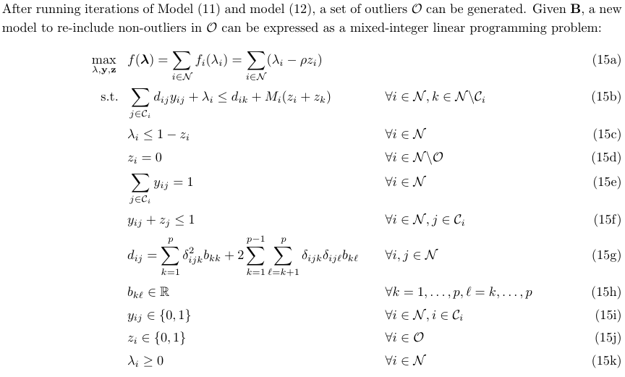
6.3 MILP
To re-add non-outliers into the dataset
<=Yij≠1 if Zj=1
<=Parameter

Slide 5
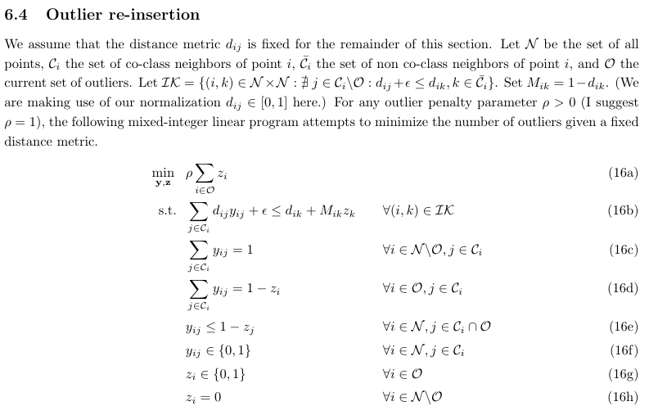
Improvement

Slide 6
Start
Whole Process of MILP
Method4
Input Data
Solve LP
Delete Outliers from data
Outliers exist?
Yes
No
Solve MILP
Output Data
End

Slide 7
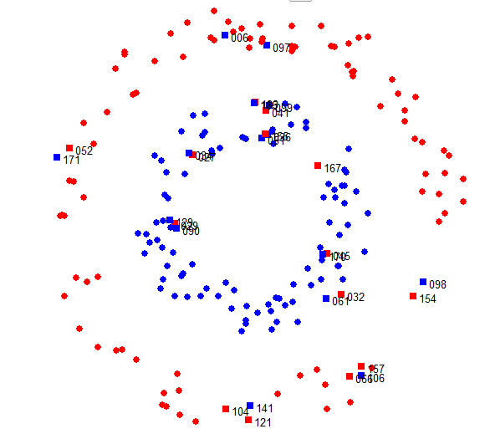
Original Data

Slide 8
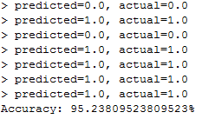
Start
Method KNN
(k-NearestNeighbor)
in python
Input Data
Split Data into Training&test set
Calculate Distance(Euclidean)
Decide value of k
Vote for class of
Testing set
Compare real value and prediction
Output Data
End

Slide 9
Start
Method KNN
(k-NearestNeighbor)
in python
Input Data
Split Data into Training&test set
Calculate Distance(Euclidean)
Decide value of k
Vote for class of
Testing set
Compare real value and prediction
Output Data
End

Slide 10
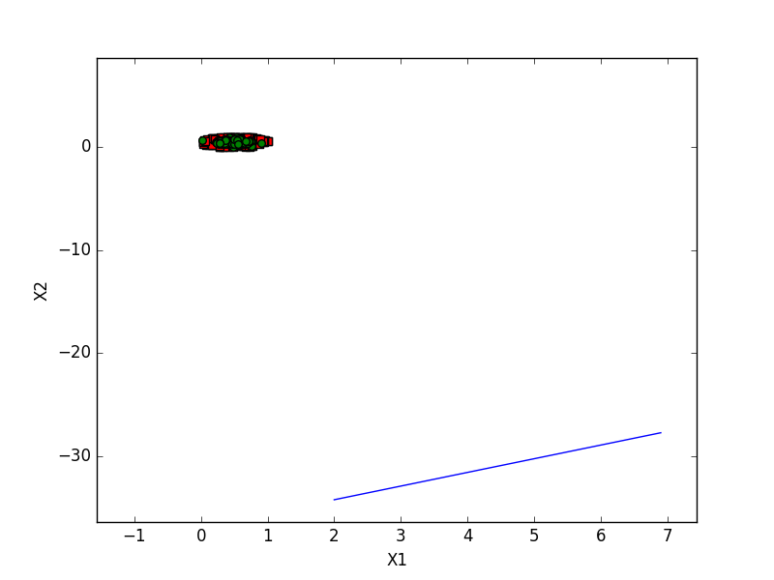

SVM
(Support Vector Machine)
Without kernel
in python

Slide 11
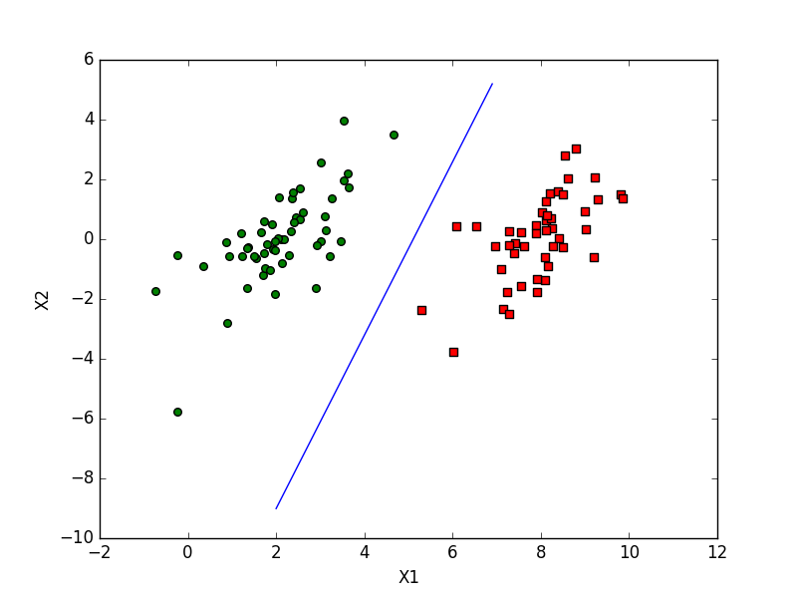

SVM
(Support Vector Machine)
Without kernel
in python

Slide 12
Pending
SVM With kernel in python
Our method in python
ANN method
Comparison of all methods we have

Slide 13
Thank you !

